Slide 1
Week 4 Update
Randy & Dylan

Slide 2
Points to take note from previous meeting
Time consuming to choose seats, so avoid it if possible
Having a Waiting List Row to allow people with extra guest to go in but not having a good seat
Special Allocations for special needs, system needs to be able to be overwritten
Planning
We know which part to block off
We know which part of the venue is meant for who
Platform have to been dynamic as it is not only cater to 1 venue

Slide 3
Ms Kareen Koh
Needed to re-ask some question
If there are seats numbers and if they are allowed to choose seats
There are are not seat numbers (free seating) and they are not allowed to choose their seating. First come first server
Do they track attendance and if they do other reports other than attendance
Yes and they only do attendance, no other reports

Slide 4
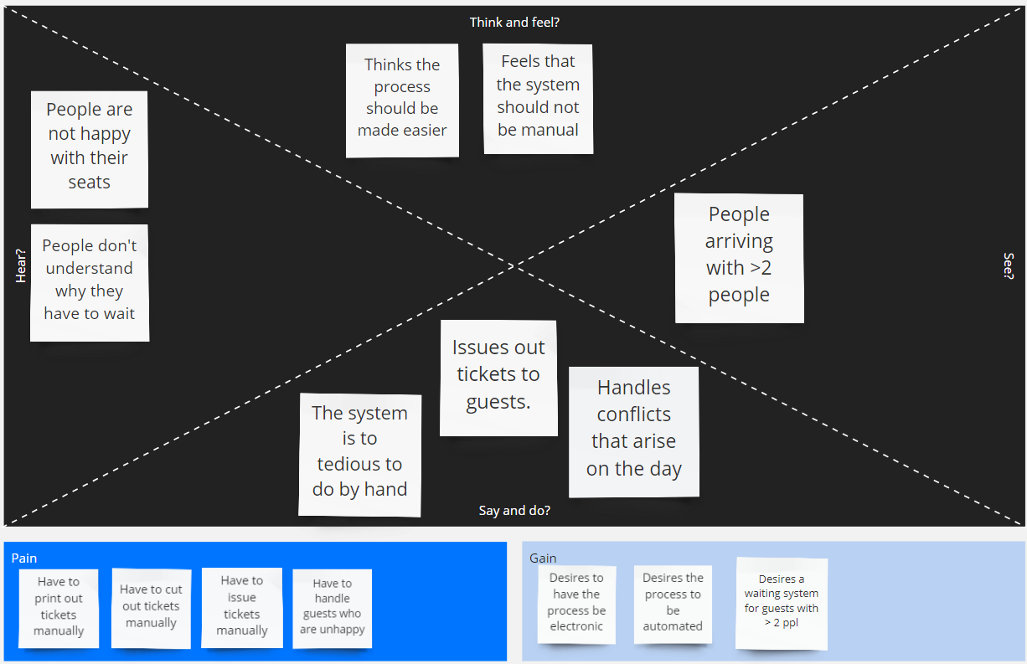
Phase 1: Empathize with User - Empathy Map

Slide 5
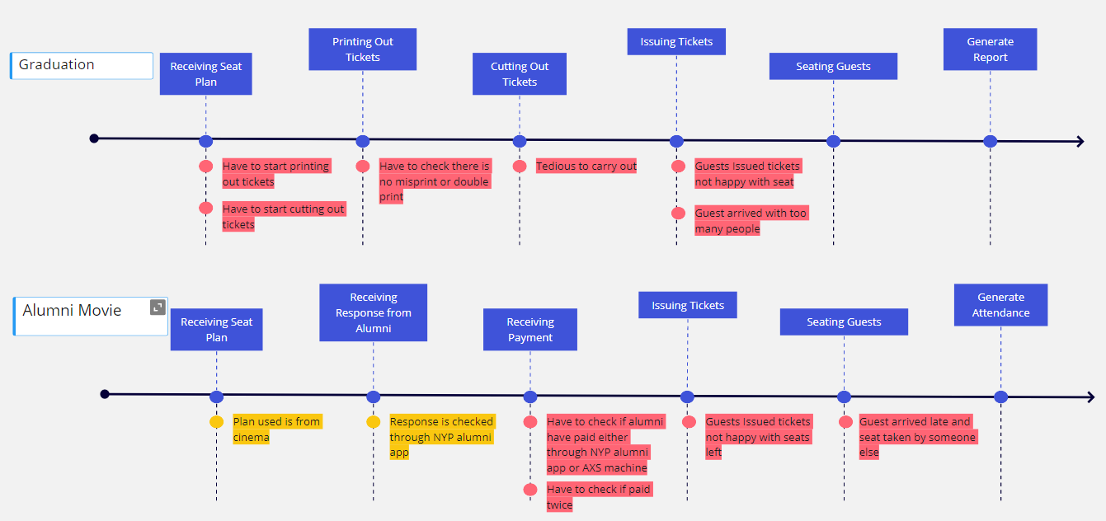
Empathize with user - Journey Map

Slide 6
User Persona
Alex (Planner)
Need to cut out tickets and check if there are no double prints manually
Alex is able to use our program to check event’s seating arrangement as well as make e-tickets for the event.
Constraint
Map should be given
Which seats is reserved for who and which seats are blocked off

Slide 7
Phase 2: Define your Intent
Before Interview
Our problem is that major events almost always takes up huge amount manpower and paper. There are also always errors involved in printing out tickets and conflicts to handle during the event as well.

Slide 8
Define your intent
After Interview
Using up a lot of manpower
Tickets are tedious to cut out & Double Checking
Attendance taking
Generating report
Dynamic design to cater to different venue
Extra guest conflict
Able to block of rows for specific guest

Slide 9
Ideate
After Interview
Using up a lot of manpower
Easy to navigate and setup so lesser manpowers will be used
Tickets are not tedious to cut out & Double Checking
Making a E-ticket instead of actual ticket
Attendance taking
Generating report
Generate report based on the the way they get their tickets
Dynamic design to cater to different venue
Making it responsive and adding more venue layout
Extra guest conflict
Waiting list for Extra guest which has a dedicated row for them

Slide 10
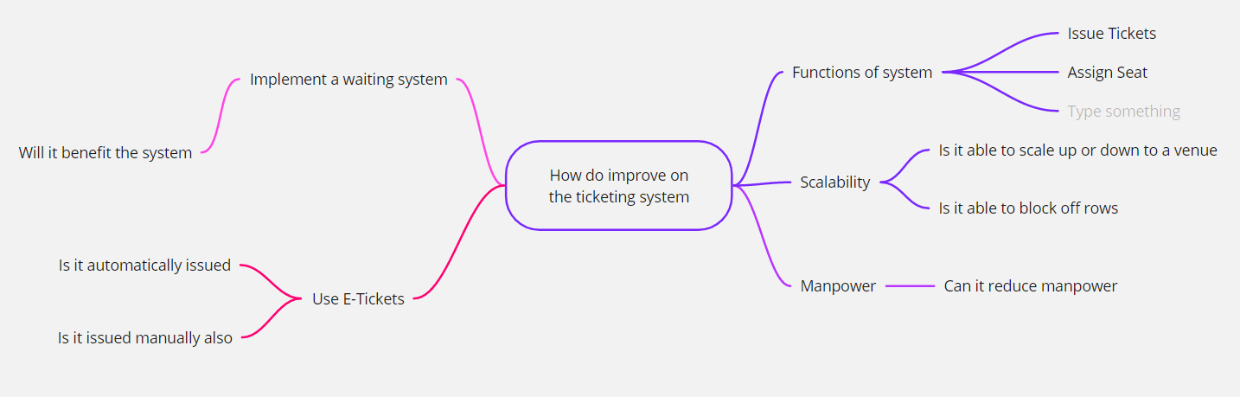
Ideate
Mind Map

Slide 11
Consolidating Problems
Similarities
Attendance taking and generating report
E-ticketing, Double Checking and Using of too much manpower
Crucial functions
E-ticketing
Venue
Rows to block off

